Slide 1
BIG DATA PLANNING CONSIDERATIONS
UNIT VI

Slide 2
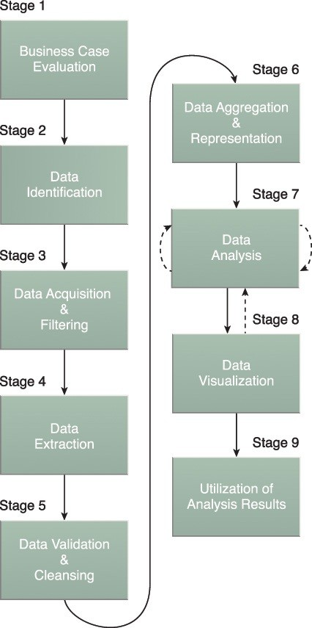
The Big Data analytics lifecycle can be divided into the following nine stages, as shown in
1. Business Case Evaluation
2. Data Identification
3. Data Acquisition & Filtering
4. Data Extraction
5. Data Validation & Cleansing
6. Data Aggregation & Representation
7. Data Analysis
8. Data Visualization
9. Utilization of Analysis Result

Slide 3
Business Case Evaluation
Each Big Data analytics lifecycle must begin with a well-defined business case that presents a clear understanding of the justification, motivation and goals of carrying out the analysis.
The Business Case Evaluation stage requires that a business case be created, assessed and approved prior to proceeding with the actual hands-on analysis tasks.

Slide 4
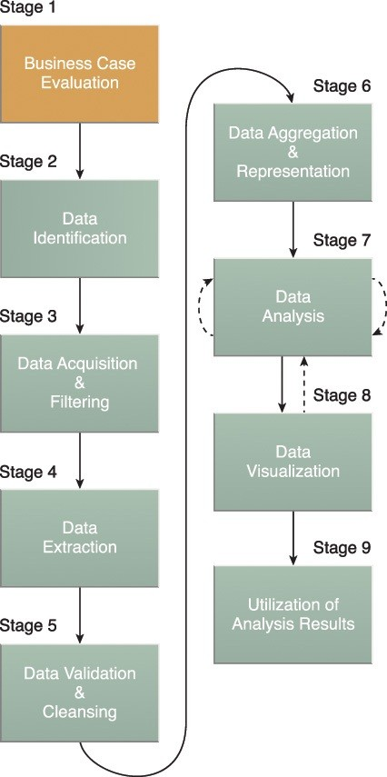

Slide 5

The Business Case Evaluation stage requires that a business case be created, assessed and _________________ prior to proceeding with the actual hands-on analysis tasks
Approved
Executed
Processed
All of the above

Slide 6
An evaluation of a Big Data analytics business case helps decision-makers understand the business resources that will need to be utilized and which business challenges the analysis will tackle.
The further identification of KPIs during this stage can help determine assessment criteria and guidance for the evaluation of the analytic results.
If KPIs are not readily available, efforts should be made to make the goals of the analysis project SMART, which stands for specific, measurable, attainable, relevant and timely.
Based on business requirements that are documented in the business case, it can be determined whether the business problems being addressed are really Big Data problems

Slide 7
In order to qualify as a Big Data problem, a business problem needs to be directly related to one or more of the Big Data characteristics of volume, velocity, or variety.
Note also that another outcome of this stage is the determination of the underlying budget required to carry out the analysis project.
Any required purchase, such as tools, hardware and training, must be understood in advance so that the anticipated investment can be weighed against the expected benefits of achieving the goals.
Initial iterations of the Big Data analytics lifecycle will require more up-front investment of Big Data technologies, products and training compared to later iterations where these earlier investments can be repeatedly leveraged.

Slide 8
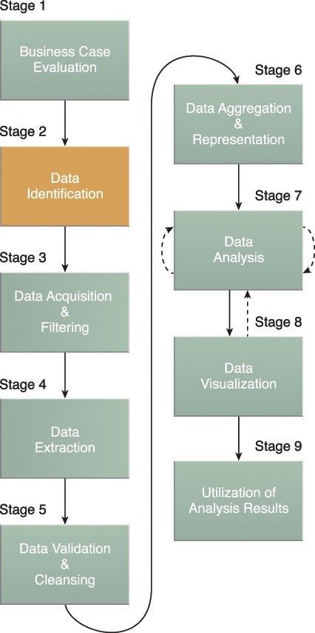
Data Identification
The Data Identification stage is dedicated to identifying the datasets required for the analysis project and their sources.

Slide 9
Identifying a wider variety of data sources may increase the probability of finding hidden patterns and correlations.
For example, to provide insight, it can be beneficial to identify as many types of related data sources as possible, especially when it is unclear exactly what to look for.
Depending on the business scope of the analysis project and nature of the business problems being addressed, the required datasets and their sources can be internal and/or external to the enterprise.

Slide 10
In the case of internal datasets, a list of available datasets from internal sources, such as data marts and operational systems, are typically compiled and matched against a pre- defined dataset specification.
In the case of external datasets, a list of possible third-party data providers, such as data markets and publicly available datasets, are compiled.
Some forms of external data may be embedded within blogs or other types of content-based web sites, in which case they may need to be harvested via automated tools.

Slide 11
Which of the following is third-party data providers
A Data Markets
B Public repositories
C. Online surveys
D. None of the above

Slide 12
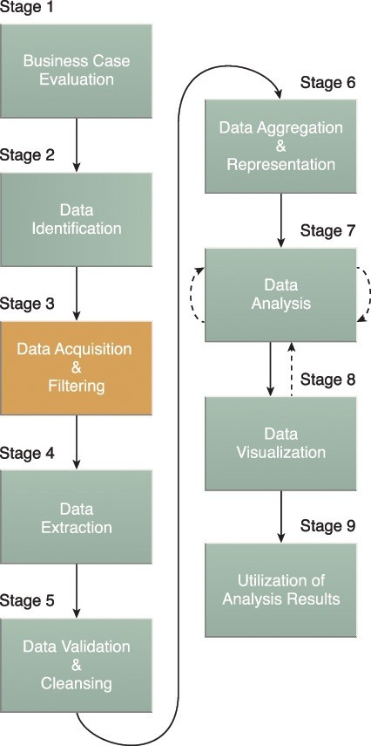

Slide 13
Depending on the type of data source, data may come as a collection of files, such as data purchased from a third-party data provider, or may require API integration, such as with Twitter.
In many cases, especially where external, unstructured data is concerned, some or most of the acquired data may be irrelevant (noise) and can be discarded as part of the filtering process.
Data classified as “corrupt” can include records with missing or nonsensical values or invalid data types.
Data that is filtered out for one analysis may possibly be valuable for a different type of analysis.
Therefore, it is advisable to store a verbatim copy of the original dataset before proceeding with the filtering.
To minimize the required storage space, the verbatim copy can be compressed.

Slide 14
Both internal and external data needs to be persisted once it gets generated or enters the enterprise boundary.
For batch analytics, this data is persisted to disk prior to analysis.
In the case of real-time analytics, the data is analyzed first and then persisted to disk.
The metadata can be added via automation to data from both internal and external data sources to improve the classification and querying.
Examples of appended metadata include dataset size and structure, source information, date and time of creation or collection and language-specific information.
It is vital that metadata be machine-readable and passed forward along subsequent analysis stages.
This helps maintain data provenance throughout the Big Data analytics lifecycle, which helps to establish and preserve data accuracy and quality.

Slide 15
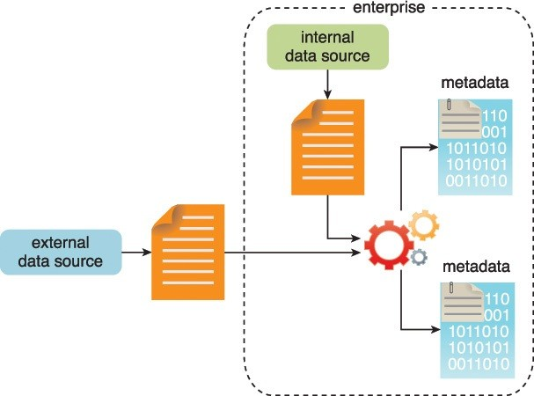

Slide 16
Data Extraction
Some of the data identified as input for the analysis may arrive in a format incompatible with the Big Data solution.
The need to address disparate types of data is more likely with data from external sources.
The Data Extraction lifecycle stage, is dedicated to extracting disparate data and transforming it into a format that the underlying Big Data solution can use for the purpose of the data analysis.

Slide 17
The metadata can be added via automation to data from ________________data sources to improve the classification and querying.
Internal source only
External Sources
Both Internal and external sources
None of the above

Slide 18
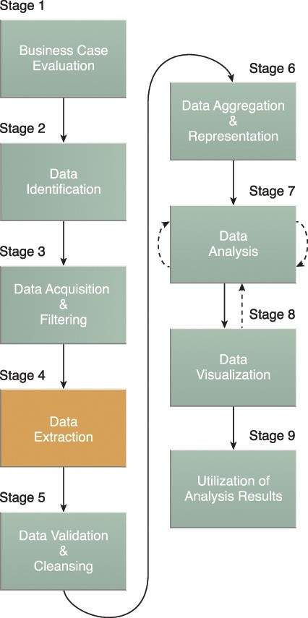

Slide 19
The extent of extraction and transformation required depends on the types of analytics and capabilities of the Big Data solution.
For example, extracting the required fields from delimited textual data, such as with webserver log files, may not be necessary if the underlying Big Data solution can already directly process those files.
Similarly, extracting text for text analytics, which requires scans of whole documents, is simplified if the underlying Big Data solution can directly read the document in its native format.
The extraction of comments and a user ID embedded within an XML document without the need for further transformation is also shown here

Slide 20
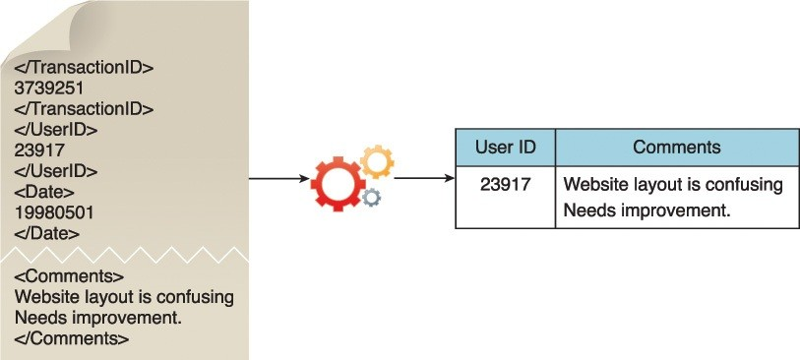

Slide 21
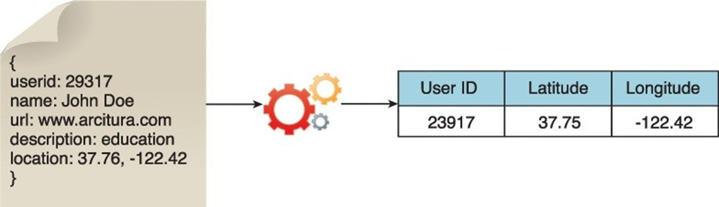
Further transformation is needed in order to separate the data into two separate fields as required by the Big Data solution.

Slide 22
Data Validation and Cleansing
Invalid data can skew and falsify analysis results. Unlike traditional enterprise data, where the data structure is pre-defined and data is pre-validated, data input into Big Data analyses can be unstructured without any indication of validity.
Its complexity can further make it difficult to arrive at a set of suitable validation constraints.
The Data Validation and Cleansing stage is dedicated to establishing often complex validation rules and removing any known invalid data.

Slide 23
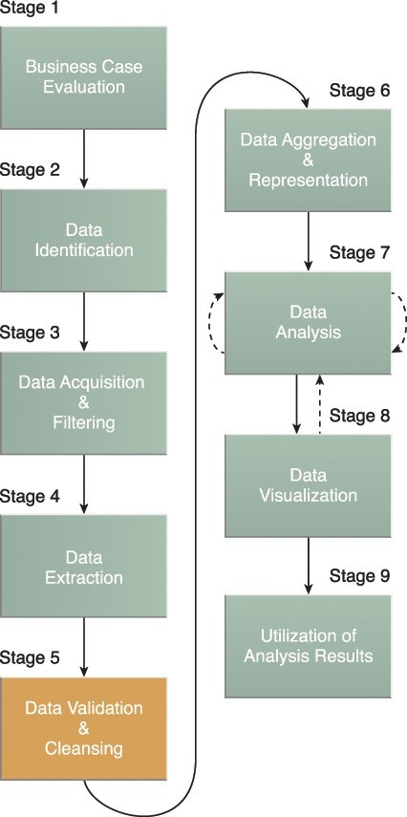

Slide 24
In traditional enterprise data, the data
a. Data Structure is Predefined and data is pre-validated
b. Data is predefined only
c. Data is not validated until later stage .
d. None of the above

Slide 25
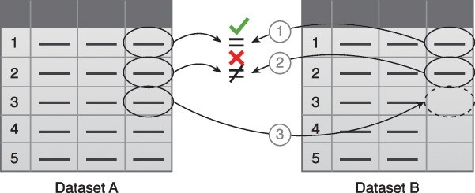
Big Data solutions often receive redundant data across different datasets
This redundancy can be exploited to explore interconnected datasets in order to assemble validation parameters and fill in missing valid data.
The first value in Dataset B is validated against its corresponding value in Dataset A.
The second value in Dataset B is not validated against its corresponding value in Dataset A.
If a value is missing, it is inserted from Dataset A.

Slide 26

For batch analytics, data validation and cleansing can be achieved via an offline ETL operation.
For real-time analytics, a more complex in-memory system is required to validate and cleanse the data as it arrives from the source.
Provenance can play an important role in determining the accuracy and quality of questionable data. Data that appears to be invalid may still be valuable in that it may possess hidden patterns and trends
The presence of invalid data is resulting in spikes. Although the data appears abnormal, it may be indicative of a new pattern.

Slide 27
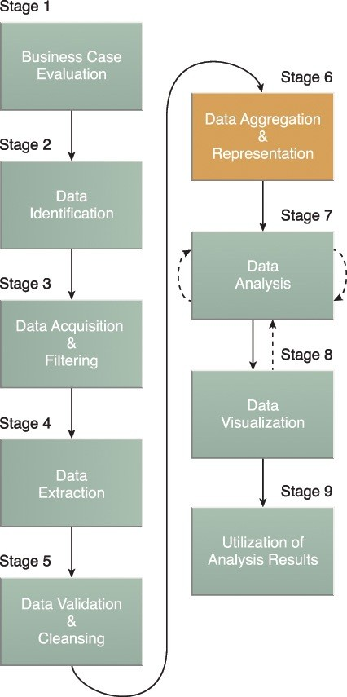

Slide 28
Performing this stage can become complicated because of differences in:
Data Structure – Although the data format may be the same, the data model may be different.
Semantics – A value that is labeled differently in two different datasets may mean the same thing, for example “surname” and “last name.”
The large volumes processed by Big Data solutions can make data aggregation a time and effort-intensive operation. Reconciling these differences can require complex logic that is executed automatically without the need for human intervention.

Slide 29
Future data analysis requirements need to be considered during this stage to help foster data reusability.
Whether data aggregation is required or not, it is important to understand that the same data can be stored in many different forms.
One form may be better suited for a particular type of analysis than another.
For example, data stored as a BLOB would be of little use if the analysis requires access to individual data fields.
A data structure standardized by the Big Data solution can act as a common denominator that can be used for a range of analysis techniques and projects.
This can require establishing a central, standard analysis repository, such as a NoSQL database

Slide 30
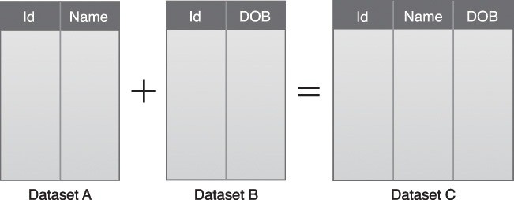
A simple example of data aggregation where two datasets are aggregated together using the Id field.

Slide 31
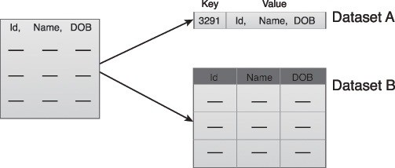
The following figure shows the same piece of data stored in two different formats.
Dataset A contains the desired piece of data, but it is part of a BLOB that is not readily accessible for querying.
Dataset B contains the same piece of data organized in column-based storage, enabling each field to be queried individually.
Dataset A and B can be combined to create a tandardized data structure with a Big Data solution.

Slide 32
Data Analysis
The Data Analysis stage is dedicated to carrying out the actual analysis task, which typically involves one or more types of analytics.
This stage can be iterative in nature, especially if the data analysis is exploratory, in which case analysis is repeated until the appropriate pattern or correlation is uncovered.
The exploratory analysis approach will be explained shortly, along with confirmatory analysis.

Slide 33
Data analysis stage can be iterative in nature.
True
False

Slide 34
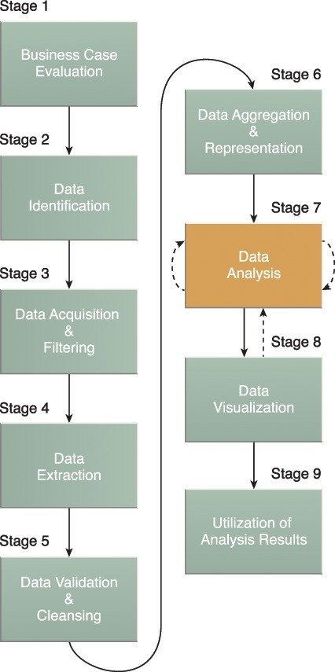
Stage 7 of the Big Data analytics lifecycle.

Slide 35
Depending on the type of analytic result required, this stage can be as simple as querying a dataset to compute an aggregation for comparison. On the other hand, it can be as challenging as combining data mining and complex statistical analysis techniques to discover patterns and anomalies or to generate a statistical or mathematical model to depict relationships between variables.
Data analysis can be classified as confirmatory analysis or exploratory analysis, the latter of which is linked to data mining, as shown in the following figure.

Slide 36
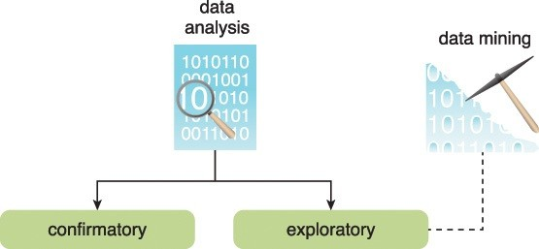

Slide 37
Confirmatory data analysis is a deductive approach where the cause of the phenomenon being investigated is proposed beforehand. The proposed cause or assumption is called a hypothesis. The data is then analyzed to prove or disprove the hypothesis and provide definitive answers to specific questions. Data sampling techniques are typically used.
Unexpected findings or anomalies are usually ignored since a predetermined cause was assumed.

Slide 38
Exploratory data analysis is an inductive approach that is closely associated with data mining.
No hypothesis or predetermined assumptions are generated. Instead, the data is explored through analysis to develop an understanding of the cause of the phenomenon.
Although it may not provide definitive answers, this method provides a general direction that can facilitate the discovery of patterns or anomalies.

Slide 39
Data Visualization
The ability to analyze massive amounts of data and find useful insights carries little value if the only ones that can interpret the results are the analysts.
The Data Visualization stage is dedicated to using data visualization techniques and tools to graphically communicate the analysis results for effective interpretation by business users.

Slide 40
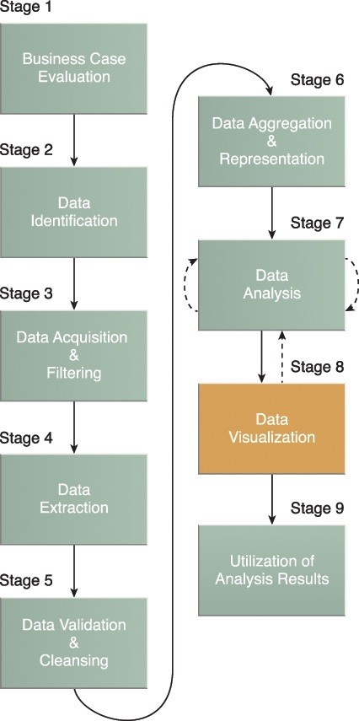

Slide 41
Business users need to be able to understand the results in order to obtain value from the analysis and subsequently have the ability to provide feedback, as indicated by the dashed line leading from stage 8 back to stage 7.
The results of completing the Data Visualization stage provide users with the ability to perform visual analysis, allowing for the discovery of answers to questions that users have not yet even formulated.

Slide 42
The same results may be presented in a number of different ways, which can influence the interpretation of the results.
Consequently, it is important to use the most suitable visualization technique by keeping the business domain in context.
Another aspect to keep in mind is that providing a method of drilling down to comparatively simple statistics is crucial, in order for users to understand how the rolled up or aggregated results were generated.

Slide 43
Utilization of Analysis Results
Subsequent to analysis results being made available to business users to support business decision-making, such as via dashboards, there may be further opportunities to utilize the analysis results.
The Utilization of Analysis Results stage is dedicated to determining how and where processed analysis data can be further leveraged.

Slide 44
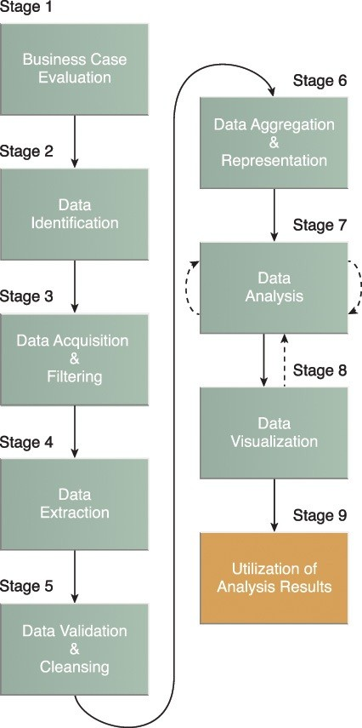

Slide 45
The Utilization of Analysis Results stage is dedicated to determining ____________________processed analysis data can be further leveraged.
A. What and why
B. By whom
C. How and Where
D. None of the above

Slide 46
Depending on the nature of the analysis problems being addressed, it is possible for the analysis results to produce “models” that encapsulate new insights and understandings about the nature of the patterns and relationships that exist within the data that was analyzed.
A model may look like a mathematical equation or a set of rules. Models can be used to improve business process logic and application system logic, and they can form the basis of a new system or software program.

Slide 47
Common areas that are explored during this stage include the following:
Input for Enterprise Systems – The data analysis results may be automatically or manually fed directly into enterprise systems to enhance and optimize their behaviors and performance. For example, an online store can be fed processed customer-related analysis results that may impact how it generates product recommendations. New models may be used to improve the programming logic within existing enterprise systems or may form the basis of new systems.

Slide 48
Business Process Optimization – The identified patterns, correlations and anomalies discovered during the data analysis are used to refine business processes. An example is consolidating transportation routes as part of a supply chain process. Models may also lead to opportunities to improve business process logic.
Alerts – Data analysis results can be used as input for existing alerts or may form the basis of new alerts. For example, alerts may be created to inform users via email or SMS text about an event that requires them to take corrective action

Slide 49
Case Study Example
The majority of ETI’s IT team is convinced that Big Data is the silver bullet that will address all of their current issues.
However, the trained IT members point out that adopting Big Data is not the same as simply adopting a technology platform.
Rather, a range of factors first need to be considered in order to ensure successful adoption of Big Data.
Therefore, to ensure that the impact of business-related factors is fully understood, the IT team sits together with the business managers to create a feasibility report.
Involving business personnel at this early stage will further help create an environment that reduces the gap between management’s perceived expectations and what IT can actually deliver.

Slide 50
There is a strong understanding that the adoption of Big Data is business-oriented and will assist ETI in reaching its goals.
Big Data’s abilities to store and process large amounts of unstructured data and combine multiple datasets will help ETI comprehend risk.
The company hopes that, as a result, it can minimize losses by only accepting less-risky applicants as customers.
Similarly, ETI predicts that the ability to look into the unstructured behavioral data of a customer and discover abnormal behavior will further help reduce loss because fraudulent claims can be rejected.

Slide 51
The decision to train the IT team in the field of Big Data has increased ETI’s readiness for adopting Big Data.
The team believes that it now has the basic skillset required for undertaking a Big Data initiative.
Data identified and categorized earlier puts the team in a strong position for deciding on the required technologies.
The early engagement of business management has also provided insights that allow them to anticipate changes that may be required in the future to keep the Big Data solution platform in alignment with any emerging business requirements.

Slide 52
At this preliminary stage, only a handful of external data sources, such as social media and census data, have been identified.
It is agreed by the business personnel that a sufficient budget will be allocated for the acquisition of data from third-party data providers.
Regarding privacy, the business users are a bit wary that obtaining
Additional data about customers could spark customer distrust.
However, it is thought that an incentive-driven scheme, such as lower premiums, can be introduced in order to gain customers’ consent and trust.
When considering issues of security, the IT team notes that additional development efforts will be required to ensure that standardized, role-based access controls are in place for data held within the Big Data solution environment.
This is especially relevant for the open-source databases that will hold non-relational data.

Slide 53
Involving business personnel in big data implementation help in creating an environment that
a. reduces the gap between management’s perceived expectations and what IT can actually deliver
b. Can mange budget
c. Can arrange required software and hardware
d. None of the above

Slide 54
Although the business users are excited about being able to perform deep analytics through the use of unstructured data, they pose a question regarding the degree to which can they trust the results, for the analysis involves data from third-party data providers.
The IT team responds that a framework will be adopted for adding and updating metadata for each dataset that is stored and processed so that provenance is maintained at all times and processing results can be traced all the way back to the constituent data sources.
ETI’s present goals include decreasing the time it takes to settle claims and detect fraudulent claims.
The achievement of these goals will require a solution that provides results in a timely manner.
However, it is not anticipated that realtime data analysis support will be required.
The IT team believes that these goals can be satisfied by developing a batch-based Big Data solution that leverages open source Big Data technology.

Slide 55
ETI’s current IT infrastructure consists of comparatively older networking standards. Similarly, the specifications of most of the servers, such as the processor speed, disk capacity and disk speed, dictate that they are not capable of providing optimum data processing performance. Hence it is agreed that the current IT infrastructure needs an upgrade before a Big Data solution can be designed and built.
Both the business and IT teams strongly believe that a Big Data governance framework is required to not only help them standardize the usage of disparate data sources but also fully comply with any data privacy-related regulations.

Slide 56
Furthermore, due to the business focus of the data analysis and to ensure that meaningful analysis results are generated, it is decided that an iterative data analysis approach that includes business personnel from the relevant department needs to be adopted.
For example, in the “improving customer retention” scenario, the marketing and sales team can be included in the data analysis process right from the selection of datasets so that only the relevant attributes of these datasets are chosen.
Later, the business team can provide valuable feedback in terms of interpretation and applicability of the analysis results

Slide 57
With regards to cloud computing, the IT team observes that none of its systems are currently hosted in the cloud and that the team does not possess cloud-related skillsets.
These facts alongside data privacy concerns lead the IT team to the decision to build an on-premise Big Data solution.
The group notes that they will leave the option of cloud-based hosting open because there is some speculation that their internal CRM system may be replaced with a cloud-hosted, software-as-a- service CRM solution in the future.

Slide 58
Big Data Analytics Lifecycle
ETI’s Big Data journey has reached the stage where its IT team possesses the necessary skills and the management is convinced of the potential benefits that a Big Data solution can bring in support of the business goals.
The CEO and the directors are eager to see Big Data in action. In response to this, the IT team, in partnership with the business personnel, take on ETI’s first Big Data project
After a thorough evaluation process, the “detection of fraudulent claims” objective is chosen as the first Big Data solution.
The team then follows a step-by-step approach as set forth by the Big Data Analytics Lifecycle in pursuit of achieving this objective.

Slide 59
Business Case Evaluation
Carrying out Big Data analysis for the “detection of fraudulent claims” directly corresponds to a decrease in monetary loss and hence carries complete business backing. Although fraud occurs across all the four business sectors of ETI, in the interest of keeping the analysis somewhat straightforward, the scope of Big Data analysis is limited to identification of fraud in the building sector.
ETI provides building and contents insurance to both domestic and commercial customers. Although insurance fraud can both be opportunistic and organized, opportunistic fraud in the form of lying and exaggeration covers the majority of the cases. To measure the success of the Big Data solution for fraud detection, one of the KPIs set is the reduction in fraudulent claims by 15%.

Slide 60
Taking their budget into account, the team decides that their largest expense will be in the procuring of new infrastructure that is appropriate for building a Big Data solution environment.
They realize that they will be leveraging open source technologies to support batch processing and therefore do not believe that a large, initial up-front investment is required for tooling.
However, when they consider the broader Big Data analytics lifecycle, the team members realize that they should budget for the acquisition of additional data quality and cleansing tools and newer data visualization technologies.
After accounting for these expenses, a cost-benefit analysis reveals that the investment in the Big Data solution can return itself several times over if the targeted fraud-detecting KPIs can be attained.
As a result of this analysis, the team believes that a strong business case exists for using Big Data for enhanced data analysis.

Slide 61
Data Identification
A number of internal and external datasets are identified. Internal data includes policy data, insurance application documents, claim data, claim adjuster notes, incident photographs, call center agent notes and emails.
External data includes social media data (Twitter feeds), weather reports, geographical (GIS) data and census data. Nearly all datasets go back five years in time.
The claim data consists of historical claim data consisting of multiple fields where one of the fields specifies if the claim was fraudulent or legitimate.

Slide 62
Data Acquisition and Filtering
The policy data is obtained from the policy administration system, the claim data, incident photographs and claim adjuster notes are acquired from the claims management system and the insurance application documents are obtained from the document management system. The claim adjuster notes are currently embedded within the claim data. Hence a separate process is used to extract them. Call center agent notes and emails are obtained from the CRM system.

Slide 63
The rest of the datasets are acquired from third-party data providers.
A compressed copy of the original version of all of the datasets is stored on-disk.
From a provenance perspective, the following metadata is tracked to capture the pedigree of each dataset: dataset’s name, source, size, format, checksum, acquired date and number of records.
A quick check of the data qualities of Twitter feeds and weather reports suggests that around four to five percent of their records are corrupt.
Consequently, two batch data filtering jobs are established to remove the corrupt records.

Slide 64
Data Extraction
The IT team observes that some of the datasets will need to be pre-processed in order to extract the required fields.
For example, the tweets dataset is in JSON format. In order to be able to analyze the tweets, the user id, timestamp and the tweet text need to be extracted and converted to tabular form.
Further, the weather dataset arrives in a hierarchical format (XML), and fields such as timestamp, temperature forecast, wind speed forecast, wind direction forecast, snow forecast and flood forecast are also extracted and saved in a tabular form

Slide 65
Data Validation and Cleansing
To keep costs down, ETI is currently using free versions of the weather and the census datasets that are not guaranteed to be 100% accurate.
As a result, these datasets need to be validated and cleansed.
Based on the published field information, the team is able to check the extracted fields for typographical errors and any incorrect data as well as data type and range validation.
A rule is established that a record will not be removed if it contains some meaningful level of information even though some of its fields may contain invalid data.

Slide 67
Data Aggregation and Representation
For meaningful analysis of data, it is decided to join together policy data, claim data and call center agent notes in a single dataset that is tabular in nature where each field can be referenced via a data query.
It is thought that this will not only help with the current data analysis task of detecting fraudulent claims but will also help with other data analysis tasks, such as risk evaluation and speedy settlement of claims.
The resulting dataset is stored in a NoSQL database.

Slide 68
Data Analysis
The IT team involves the data analysts at this stage as it does not have the right skillset for analyzing data in support of detecting fraudulent claims.
In order to be able to detect fraudulent transactions, first the nature of fraudulent claims needs tobe analyzed in order to find which characteristics differentiate a fraudulent claim from a legitimate claim.
For this, the exploratory data analysis approach is taken.
This stage is repeated a number of times as the results generated after the first pass are not conclusive enough to comprehend what makes a fraudulent claim different from a legitimate claim.
As part of this exercise, attributes that are less indicative of a fraudulent claim are dropped while attributes that carry a direct relationship are kept or added

Slide 69
Data Visualization
The team has discovered some interesting findings and now needs to convey the results to the actuaries, underwriters and claim adjusters.
Different visualization methods are used including bar and line graphs and scatter plots.
Scatter plots are used to analyze groups of fraudulent and legitimate claims in the light of different factors, such as customer age, age of policy, number of claims made and value of claim.

Slide 70
Utilization of Analysis Results
Based on the data analysis results, the underwriting and the claims settlement users have now developed an understanding of the nature of fraudulent claims.
However, in order to realize tangible benefits from this data analysis exercise, a model based on a machine-learning technique is generated, which is then incorporated into the existing claim processing system to flag fraudulent claims.

